Slide 1


NEXT GEN EMPLOYABILITY PROGRAM
CREATING A FUTURE-READY WORKFORCE
Student Name :
JAMPA GAGAN CHANDRA
Student ID: STU6787bd30ad58c1736949040
College Name :
BVC COLLEGE OF ENGINEERING

Slide 2
CAPSTONE PROJECT SHOWCASE
Project Title
Online Auction Platform
Abstract | Problem Statement | Project Overview | Proposed Solution | Technology Used | Modelling & Results | Conclusion | Q&A

Slide 3
Abstract
1
Objective: Develop a secure and scalable online auction platform using the MERN stack.
2
Features: Real-time bidding, user authentication, secure payments, and responsive design.
3
Challenges: Managing real-time updates and ensuring data integrity.
4
Outcome: Enhanced user experience, faster bidding process, and improved transaction security.

Slide 4


Problem Statement
In the current digital landscape, traditional auction systems face several limitations:
Limited Accessibility – Physical auctions restrict participation due to geographical barriers, reducing the pool of potential buyers and sellers.
Poor User Experience – Existing online auction platforms often suffer from complex interfaces, slow response times, and a lack of real-time interaction, deterring user engagement.
Security Concerns – Many auction systems lack robust security measures, making transactions vulnerable to fraud and data breaches.
Scalability Issues – High traffic volumes can lead to server crashes and bidding delays, compromising the integrity of the auction process.
This project addresses these challenges by developing a modern, scalable, and secure online auction platform using React for the frontend and Express.js for the backend. The solution aims to provide a seamless bidding experience, secure payment gateways, and a responsive design to enhance user engagement and platform performanc

Slide 5

Project Overview
Project Name: Online Auction Platform with React and Express.js
Objective: Develop a modern auction platform for real-time bidding
and seamless user experience
Technologies Used:
Frontend: React
Backend: Express.js
Database: SQL
Key Features:
User-friendly interface
Real-time bidding
Secure payments
Scalable performance
Efficient data management
Outcome:
Enhanced user engagement
Improved security and scalability
Smooth real-time interactions

Slide 6
Proposed Solution
Developed a secure and scalable online auction platform using:
React – For a responsive and interactive user interface.
Express.js – For handling backend operations and real-time bidding.
MongoDb – For efficient data storage and management.
Core Functionalities:
Real-time auction updates using WebSockets.
User authentication and secure payment gateway integration.
Product listing and bid tracking with instant notifications.
Outcome:
Streamlined bidding process with real-time engagement.
Role-based access for buyers and sellers.
Secure and reliable auction experience for users.
Enhanced scalability and performance under high traffic.

Slide 7
Technology used
Frontend: React – For building a dynamic and responsive user interface.
Backend: Express.js – For handling server-side logic and real-time bidding.
Database: MongoDB – For efficient and scalable data storage and management.
WebSockets: For enabling real-time bid updates and notifications.
Payment Gateway: For secure and seamless transactions.
GitHub: For version control and project collaboration.

Slide 8
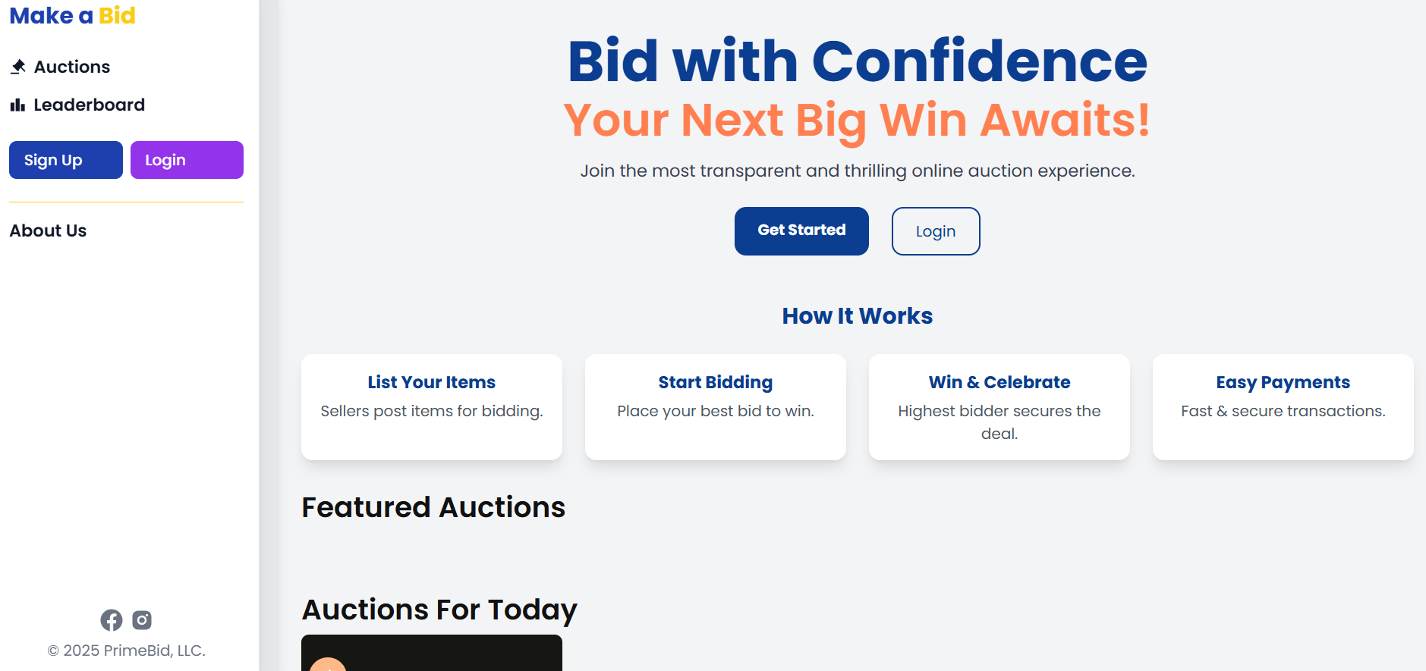
Frontend Model:
Designed using React components for a responsive and dynamic user interface.
State management with Redux for efficient data handling.
Backend Model:
Built with Express.js to manage server-side operations and
API requests.
Handled real-time bid updates using WebSockets.
Database Model:
Structured with MongoDB collections for user data, product
listings, and bids.
Ensured data integrity and fast query performance through
optimized schema design.
Modelling & Result

Slide 9
Modelling & Result
Seamless Bidding: Enabled real-time bidding with quick updates and minimal lag.
User-Friendly Interface: Intuitive design ensures ease of use for both buyers and sellers.
Notification System: Provided real-time notifications for bidding activity.
Mobile Compatibility: Ensured smooth operation on desktop and mobile devices.

Slide 10
Modelling & Result
Performance:
Handled multiple concurrent users without latency.
Efficient state and server management reduced processing time.
Security:
Secure payment integration using encrypted gateways.
Protected user data and transactions with secure authentication.
Scalability:
Efficient backend with MongoDB allows handling of high traffic.
Real-time bid updates without data conflicts.

Slide 11

Conclusion
The Online Auction Platform effectively addresses the challenges faced by traditional auction systems by delivering a secure, scalable, and real-time bidding solution. Leveraging the MERN stack, the platform ensures a seamless user experience, efficient data handling, and secure transaction processing.
Through the integration of React and Express.js, the platform enables real-time updates and responsive interactions. The use of MongoDB for data management enhances scalability, while secure authentication and encrypted payment gateways ensure user trust and data protection.
The project demonstrates a comprehensive understanding of modern web development frameworks and real-time data processing, establishing a strong foundation for future scalability and adoption. The successful implementation of this platform reflects a strategic approach to solving real-world challenges in online bidding systems.

Slide 12


Notes:
Thank You !!

